Slide 1
1. 화자 인식기
2. VAE3 재현 실험

Slide 2

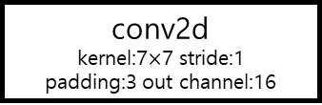
전처리 - mel-cepstrum dim: 40
Model (resnet-18)
input = (batch size, channel, dim, win)
input
(N batch size, 1 channel, 40 dim, 100 win)
conv2d
kernel:7$×$7 stride:1
padding:3 out channel:16
avg pooling
(N, 128)
(N, 16, 40, 100)
FC
BatchNorm2d
(N, 128)
ReLU
ReLU
Layer1
in channel:16 / out channel:16
FC
(N, 16, 40, 100)
(N, num of speaker)
Layer2
in channel:16 / out channel:32
1
2
$$⋯$$
m
(N, 32, 10, 25)
Layer3
in channel:32 / out channel:64
ex) [0.1862, -0.0878, … , 0.6594, -1.9130, -1.1221]
(N, 64, 3, 13)
Layer4
in channel:64 / out channel:128
(N, 128, 1, 4)

Slide 3
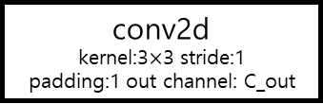
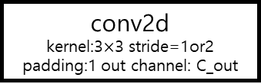
Layer1
Layer2
Basic Block
input
(N, 16, H, W)
input
(N, 16, H, W)
input
(N, C_in, H, W)
Basic Block
Basic Block
conv2d
kernel:3$×$3 stride=1or2
padding:1 out channel: C_out
(N, 32, H/2, W/2)
Basic Block
Basic Block
BatchNorm2d
output
(N, 16, H, W)
output
(N, 32, H/4, W/4)
ReLU
conv2d
kernel:3$×$3 stride:1
padding:1 out channel: C_out
Layer3
Layer4
input
(N, 32, H, W)
input
(N, 64, H, W)
BatchNorm2d
Basic Block
Basic Block
(N, 64, H/2, W/2)
(N, 128, H/2, W/2)
ReLU
Basic Block
Basic Block
output
(N, C_out, H’, W’)
output
(N, 64, H/4, W/4)
output
(N, 128, H/4, W/4)

Slide 4
training set
- 12명 화자, 각 화자별 71개 데이터
validation set
- 12명 화자, 각 화자별 10개 데이터(10048, 10013, 10025, 10054, 10029, 10033, 10062, 10078, 10034, 10006)
test set
- vcc2018 test set (12명 화자, 각 화자별 35개 데이터, 총 420개 데이터)
test | soft | hard
correct | 417 | 417
acc(%) | 99.29 | 99.29

Slide 5
실험 데이터 (각 화자별 35개 데이터 - untrained: 70개 데이터, trained: 350개 데이터)
CASE1 - untrained: TF2, TM2 / trained: SF1, SF2, SF3, SF4, SM1, SM2, SM3, SM4, TF1, TM1
CASE2 - untrained: TF1, TM1 / trained: SF1, SF2, SF3, SF4, SM1, SM2, SM3, SM4, TF2, TM2
CASE3 - untrained: SF4, SM4 / trained: SF1, SF2, SF3, SM1, SM2, SM3, TF1, TF2, TM1, TM2
CASE4 - untrained: SF3, SM3 / trained: SF1, SF2, SF4, SM1, SM2, SM4, TF1, TF2, TM1, TM2
CASE5 - untrained: SF2, SM2 / trained: SF1, SF3, SF4, SM1, SM3, SM4, TF1, TF2, TM1, TM2
CASE6 - untrained: SF1, SM1 / trained: SF2, SF3, SF4, SM2, SM3, SM4, TF1, TF2, TM1, TM2

Slide 6
CASE1 | trained |  | untrained
a-vector | soft(%) | hard(%) | soft(%) | hard(%)
a1 | 10.57 | 13.14 | 1.43 | 0
a2 | 3.43 | 3.14 | 0 | 0
a3 | 6.29 | 8 | 2.86 | 0
a4 | 2.57 | 4.29 | 0 | 0
a5 | 4.86 | 6.29 | 1.43 | 0
a6 | 10 | 12.29 | 0 | 0
CASE2 | trained |  | untrained
a-vector | soft(%) | hard(%) | soft(%) | hard(%)
a1 | 12 | 12.57 | 20 | 14.29
a2 | 1.71 | 1.71 | 11.43 | 0
a3 | 10 | 11.43 | 30 | 18.57
a4 | 7.14 | 9.43 | 18.57 | 14.29
a5 | 3.14 | 4 | 24.29 | 2.86
a6 | 6.57 | 8.29 | 44.29 | 37.14
CASE3 | trained |  | untrained
a-vector | soft(%) | hard(%) | soft(%) | hard(%)
a1 | 7.71 | 12 | 37.14 | 47.14
a2 | 6.57 | 5.43 | 15.71 | 22.86
a3 | 6 | 10.29 | 35.71 | 45.71
a4 | 2.29 | 4 | 27.14 | 32.86
a5 | 0.86 | 1.71 | 11.43 | 8.57
a6 | 5.43 | 7.14 | 34.29 | 40
CASE4 | trained |  | untrained
a-vector | soft(%) | hard(%) | soft(%) | hard(%)
a1 | 16 | 16.57 | 4.29 | 5.71
a2 | 12.86 | 15.14 | 1.43 | 0
a3 | 10.57 | 11.14 | 5.71 | 5.71
a4 | 4.86 | 7.43 | 1.43 | 1.43
a5 | 1.14 | 0.86 | 0 | 0
a6 | 10.86 | 14.29 | 1.43 | 2.86

Slide 7
CASE5 | trained |  | untrained
a-vector | soft(%) | hard(%) | soft(%) | hard(%)
a1 | 12.86 | 16.86 | 2.86 | 4.29
a2 | 3.71 | 2.57 | 8.57 | 10
a3 | 9.71 | 10.57 | 1.43 | 7.14
a4 | 7.71 | 10 | 1.43 | 2.86
a5 | 7.71 | 6.86 | 0 | 4.29
a6 | 17.43 | 18.86 | 1.43 | 5.71
CASE6 | trained |  | untrained
a-vector | soft(%) | hard(%) | soft(%) | hard(%)
a1 | 11.14 | 14.86 | 0 | 0
a2 | 6 | 5.14 | 1.43 | 7.14
a3 | 8 | 11.71 | 1.43 | 0
a4 | 6 | 8 | 0 | 0
a5 | 6.57 | 6 | 0 | 0
a6 | 8.57 | 12.57 | 2.86 | 4.29
Average | trained |  | untrained
a-vector | soft(%) | hard(%) | soft(%) | hard(%)
a1 | 11.71 | 14.33 | 10.95 | 11.90
a2 | 5.71 | 5.52 | 6.43 | 6.67
a3 | 8.43 | 10.52 | 12.86 | 12.86
a4 | 5.10 | 7.19 | 8.10 | 8.57
a5 | 4.05 | 4.29 | 6.19 | 2.62
a6 | 9.81 | 12.24 | 14.05 | 15
[ CASE 1,2,3,4,5,6 ]

Slide 8
VAE3 재현 실험

Slide 9
VAE3 with shared weight
Epoch : 2000
Learning rate : Linear decay [ 1e-2 , 1e-0 ]
Reconstruction : KL divergence = 5:1

Slide 10
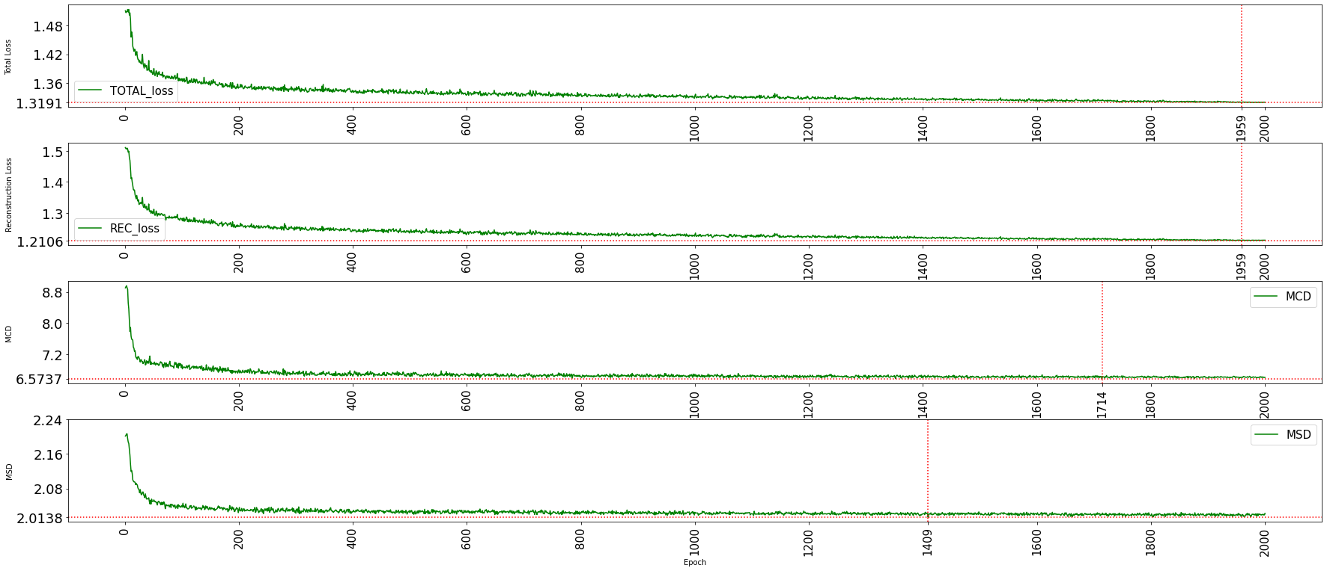
이전 실험

Slide 11
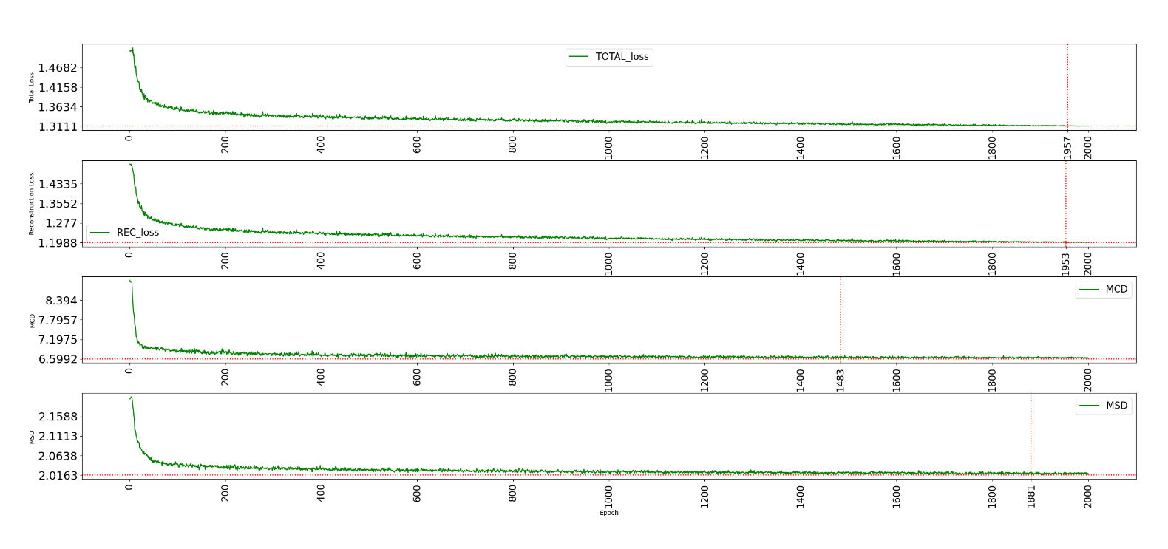
재현 실험

Slide 12
min value (epoch) exp type | Total loss | Reconstruction loss | MCD | MCD at 2000 | MSD
이전 실험 VAE3 (shared weight) | 1.3191 (1959) | 1.2106 (1959) | 6.5737 (1714) | 6.6065 (2000) | 2.0138 (1409)
재현 실험 VAE3 (shared weight) | 1.3111 (1957) | 1.1988 (1953) | 6.5992 (1483) | 6.6222 (2000) | 2.0163 (1881)

